Slide 1
Pyrochlore Ingot Niobium SRF Technology for
Next Generation
Continuous Wave Accelerators
Ganapati Myneni
LBNL
June 3, 2013

Slide 2
Overview
Introduction
Fine grain - ingot niobium technologies
Cavity process optimization
Accelerator cost and sustainable operation
Summary and outlook

Slide 3
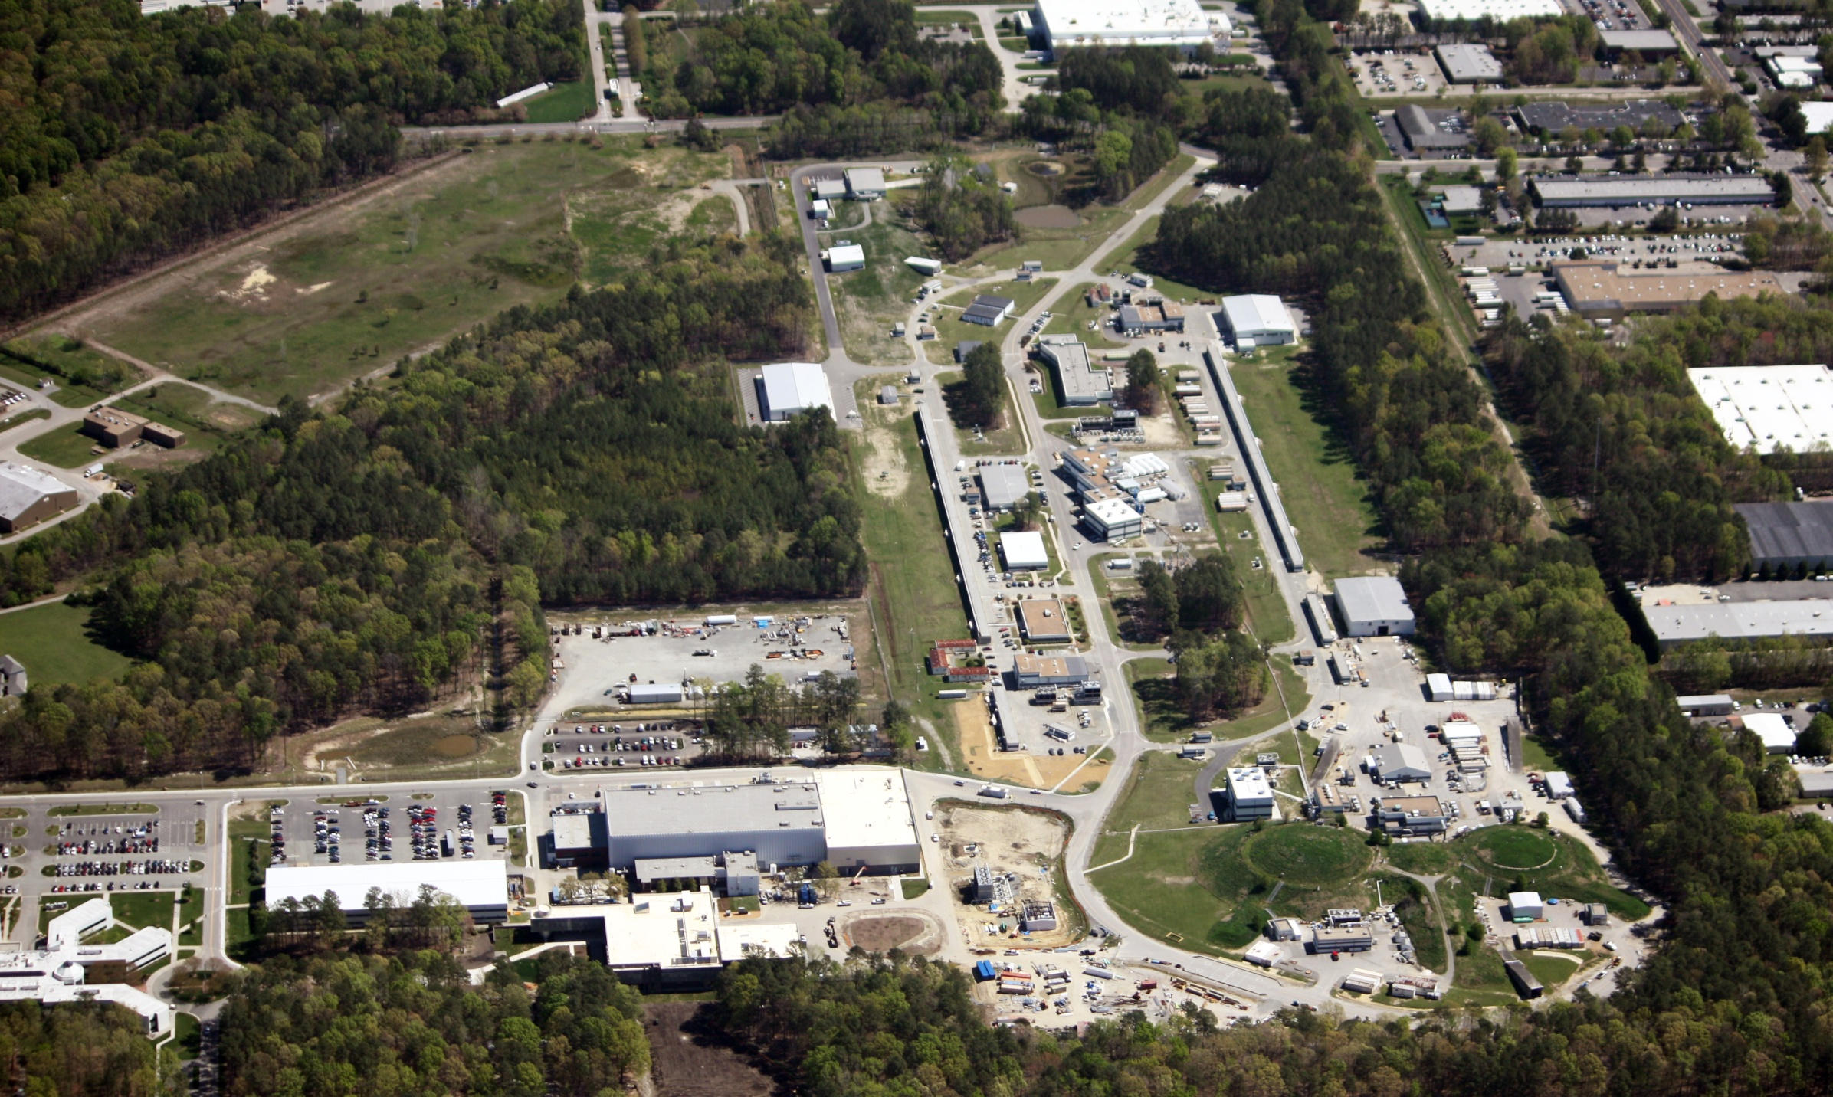

Slide 4
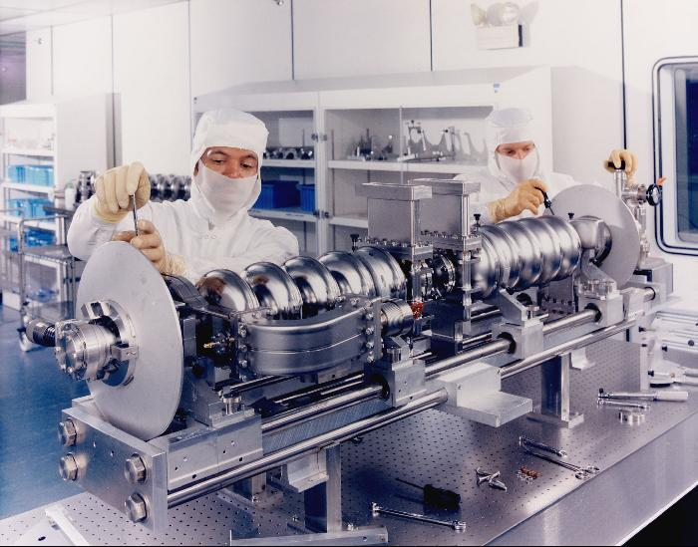
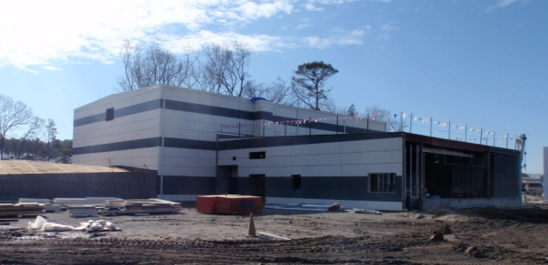
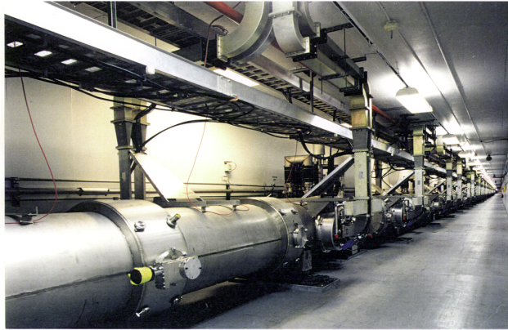
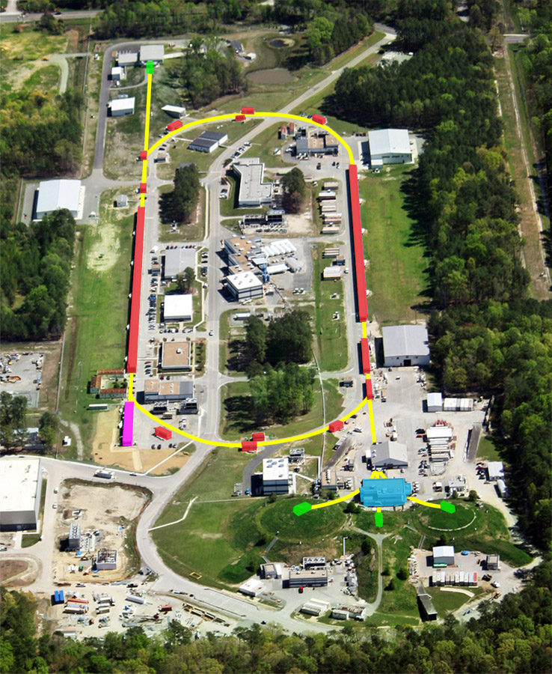
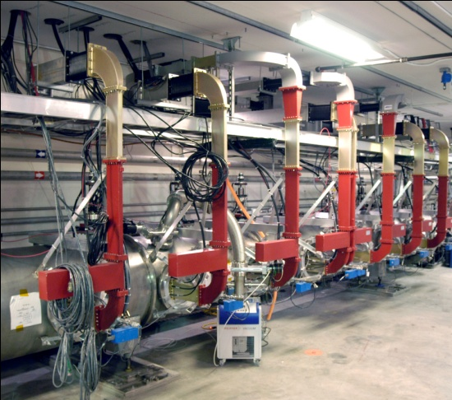
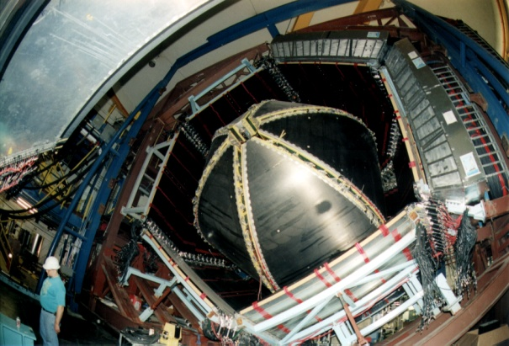
Jefferson Lab Accelerator Complex
Cryomodules in the accelerator tunnel
Superconducting radiofrequency (SRF) cavities
Hall D (new construction)
Free Electron Laser (FEL)
A
B
C
CEBAF Large Acceptance Spectrometer (CLAS) in Hall B

Slide 5
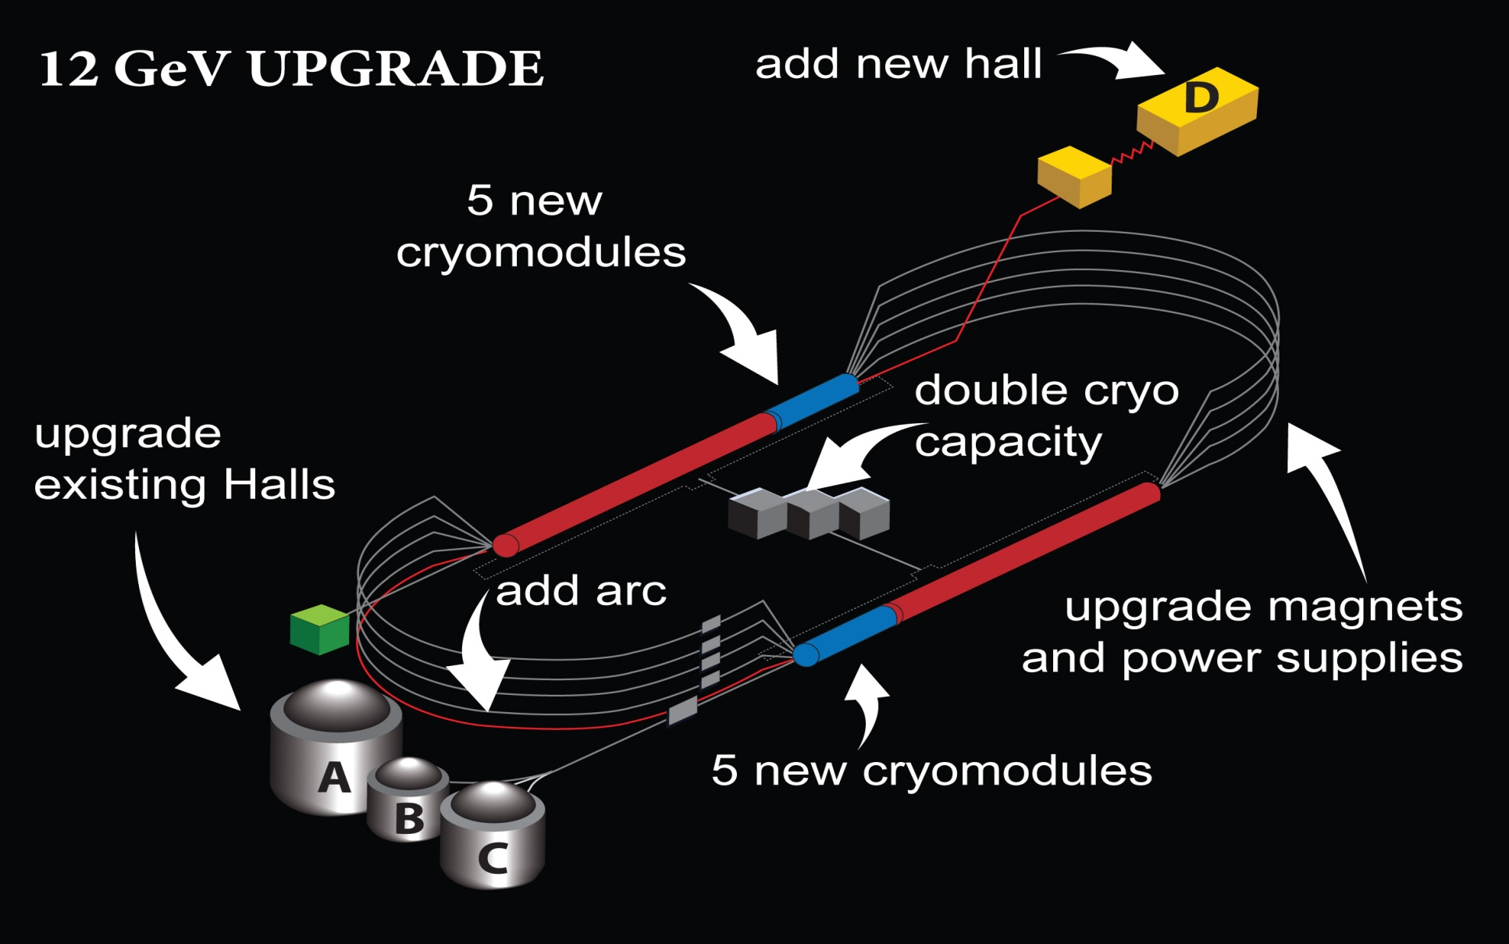
CEBAF energy upgrade

Slide 6
Introduction
Bulk RRR – Residual Resistance Ratio ~ R₃₀₀/R_{4.2}
  Has no influence on superconducting rf properties (thermal stabilization)
Important Interstitials H, C, N and O that contribute to RRR significantly
  and tantalum, substitutional impurity does not significantly contribute to RRR
Quality Factor Q₀= G/R_{s,} where G is the geometry factor and it is independent of the cavity frequency & R_{s} = R₀+R_{BCS}(f,T,l_{en}), ideal ~ 2×10 ¹¹ @ 2 K
Figure of merit of Nb ~ Q₀*E_{quench}

Slide 7
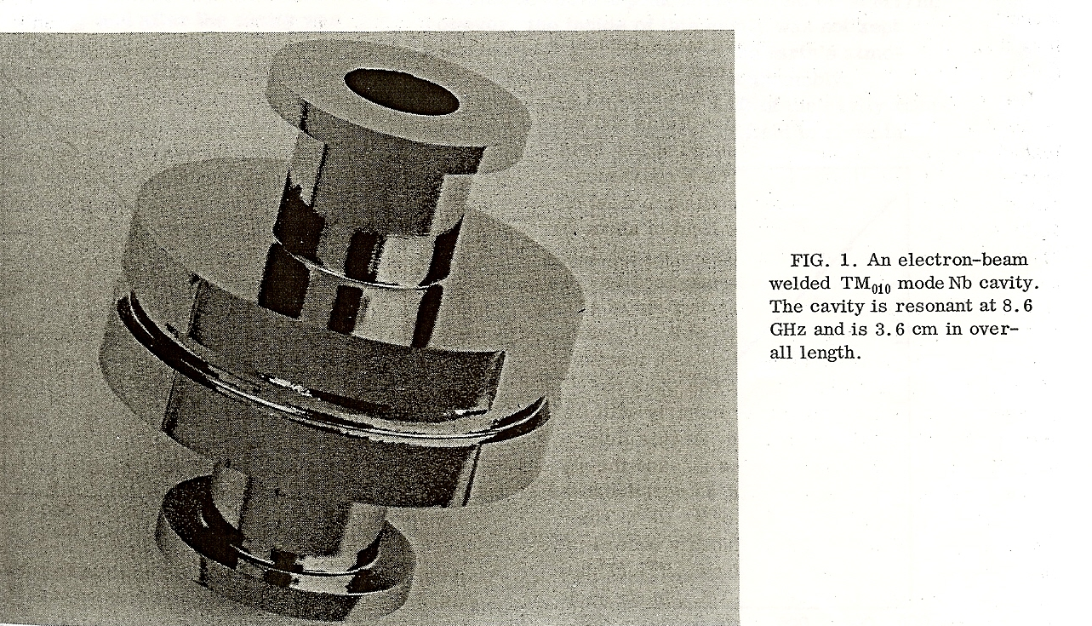
Historical Example of Ingot Niobium
H_{pk}~ 108 mT with BCP
Stanford solid niobium cavity 1970

Slide 8
Niobium Specifications
Polycrystalline Niobium with ASTM #5 Grain Size or finer ~ 50 micro meters & fully recrystallized
Percentage of elongation > 25
Yield Strength > 10.7 KSI (~75 MPa) (~40 Mpa)
RRR > 250 (>300)
Tantalum < 1000 wt ppm (<500 wt ppm)
Original CEBAF was built with 90% pyrochlore CBMM niobium

Slide 9
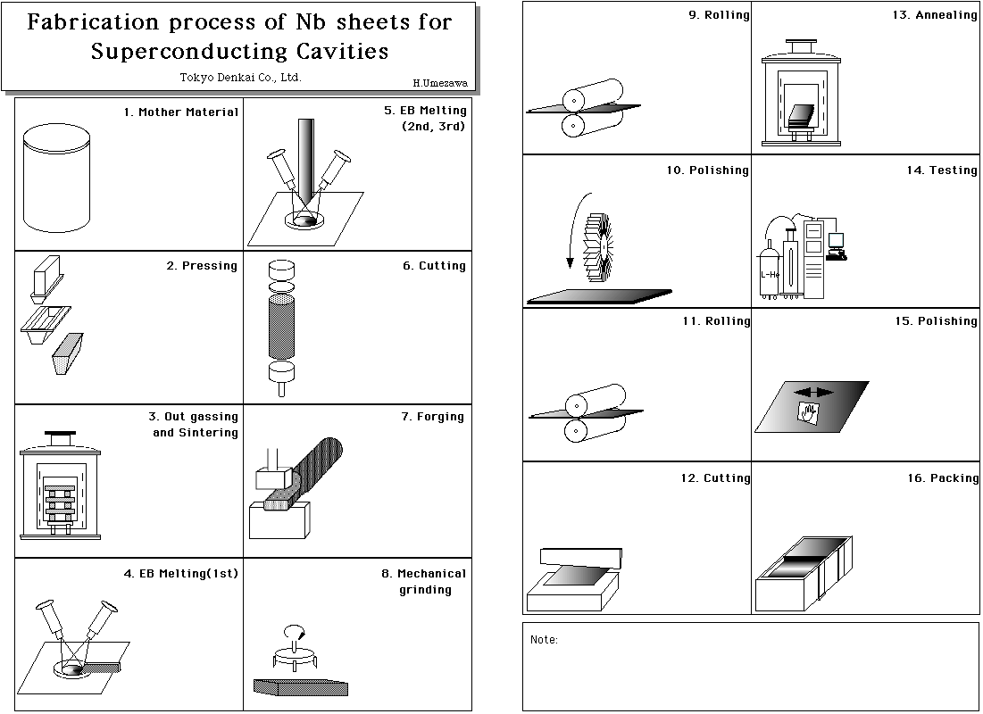
Process steps - fine grain Niobium
During this process foreign materials
can be embedded so QA is required

Slide 10
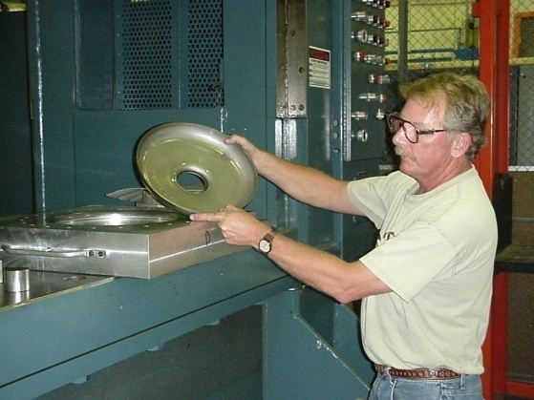
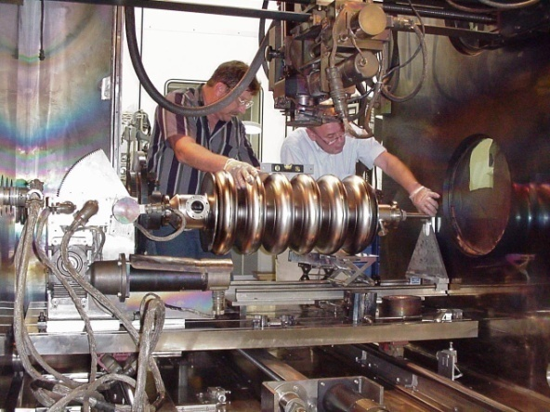
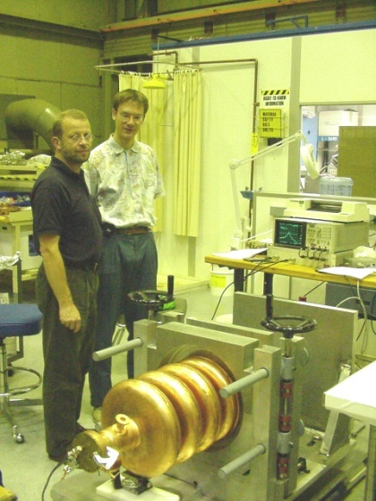
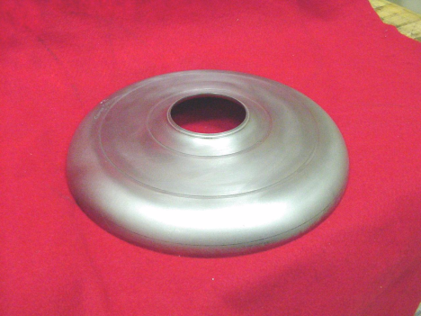
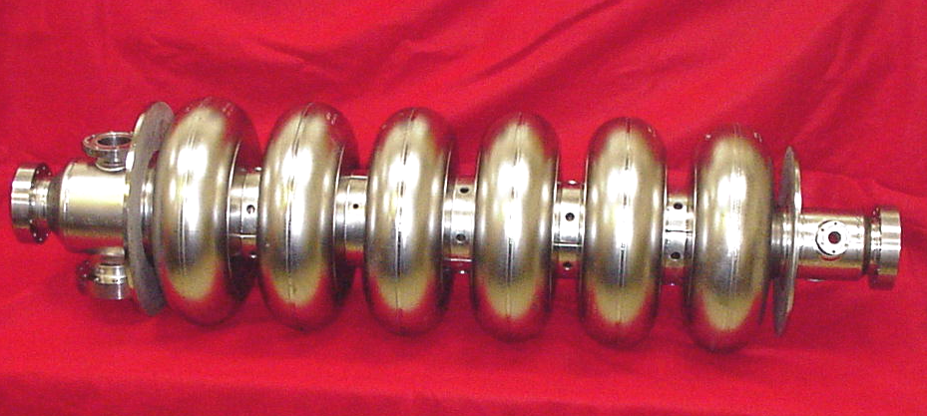
Multi cell cavity fabrication
Forming Machining Welding Tuning
~90% of CEBAF cavities were made with CBMM Pyrochlore ore based niobium
In comparison to present day use of Tantalite/Columbite ore based niobium

Slide 11
Extrinsic contamination of cavity dominated until after CEBAF construction
Surface contamination
  Molecular and particulate

Slide 12
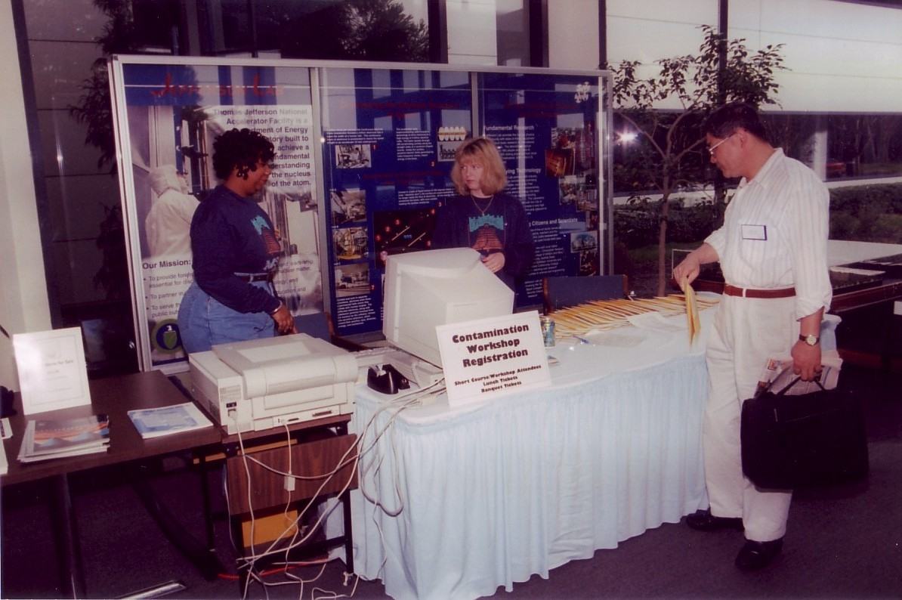
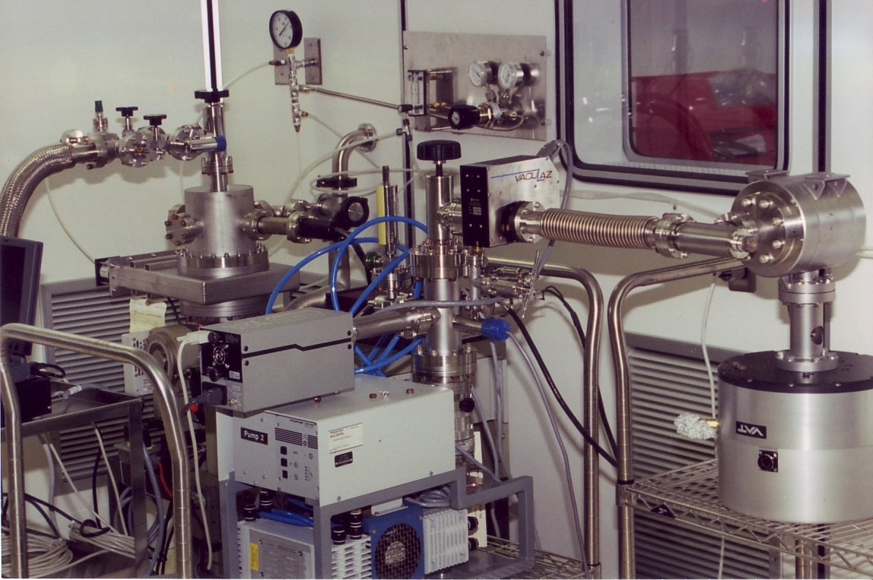
Vacuum Contamination Work Shop at JLab 1997
Minimizing organic and particulate recontamination addressed,
several courses were held in subsequent years

Slide 13
Cavity processing steps
Buffer chemical polishing (BCP) ~ 150 micro meters
Electro polishing (EP) ~ 50 micro meters
High pressure ultra pure water rinse
~ 600 – 900 °C heat treatment
Light EP
High pressure ultra pure water rinse
Vacuum bake ~120 °C for up to 48 hours
RF test

Slide 14
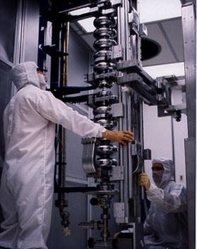
Niobium cavity – performance (CW)
SRF Technology Potential
RRR Range ~ 150 - 450
TESLA single cells with ingot Nb
and un-optimized processes
Lowers operating cost
*
ILC
*
12 GeV Upgrade Spec
*
CEBAF Operations
*
CEBAF Spec
Lowers construction cost
RRR, type of niobium and vendor has no influence on cavity performance
Development of Large Grain/Single Crystal Niobium Cavity Technology at Jefferson Lab
P. Kneisel, G. Myneni, G. Ciovati, T. Carneiro Proc of Linac 2004

Slide 15
Niobium For SRF Cavities
At present, Niobium for SRF cavities comes from Columbite/Tantalite ore
  Niobium is present as “impurity”
  Niobium is produced as a by-product of Tantalum
Primary reason – the Tantalum content is lower
  Tantalum is generally believed to negatively impact SRF properties of Niobium but there is no real data to back it up
  JLab data shows reducing Tantalum content below 1000 ppm has no advantage for Superconducting RF cavities
  Low Tantalum niobium is relatively expensive

Slide 16
Ingot Niobium Technology
CBMM-JLab CRADA, August 2004
CBMM/JLab jointly applied for US Patent in April 2005 and the patent 8128765 B2 was granted on March 6, 2012. G. Myneni, P. Kneisel and T. Carneiro (CBMM) are the inventors
Many international institutions in Asia, Europe and America are developing ingot niobium cavities. DESY, KEK are among them., AES, Niowave and RI industries are involved.CBMM, Heraues, Ningxia, Tokyo Denkai and Wah Chang are able to provide ingot niobium
W. Singer Private Communication
DESY sets E_{acc} world record with ingot niobium 9 cell TESLA cavities

Slide 17

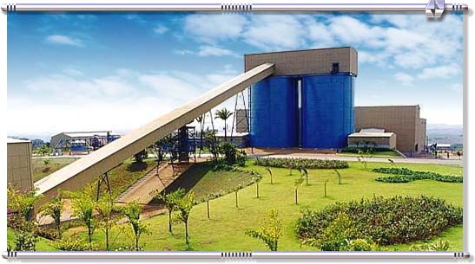
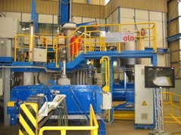
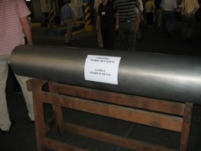
Araxá Mine in Brazil & Pyrochlore Niobium
Original CEBAF 90% CBMM Nb
The CBMM open cast mine
Conveyor belt bringing the ore to concentration plant
Electron beam furnace for the refinement of
Niobium metal, producing 210 tons per annum
Finished Nb ingot from the Pyrochlore ore
Tantalum is an impurity and the amount depends on the location of the ore and can be up to ~ 1500 wt ppm
and is uniformly distributed in niobium
Simplified niobium spec: ingot slices with Hv ~ 50

Slide 18
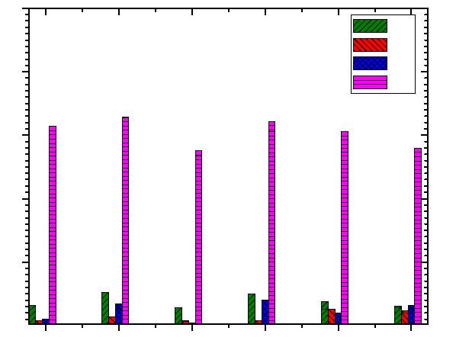
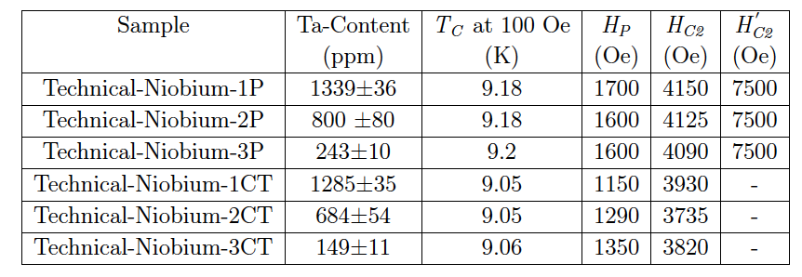
Uniform distribution of Ta has no effect on SC Parameters, BCP has large effect
Fe
Cu
Zn
Ta
S. B. Roy et al Supercond. Sci. Technol. 25 (2012) 115020

Slide 19
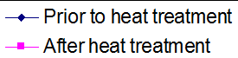
Tantalum does not affect the performance
Ingot niobium has superior performance
Large grain ingot niobium
Polycrystalline niobium
Empirically FOM ~ 1.0 x10¹³
Influence of Ta content in high purity niobium on cavity performance
P. Kneisel, G. Myneni, G. Ciovati, D. Proch, W. Singer, T. Carneiro et al in Proceedings of PAC 2005

Slide 20
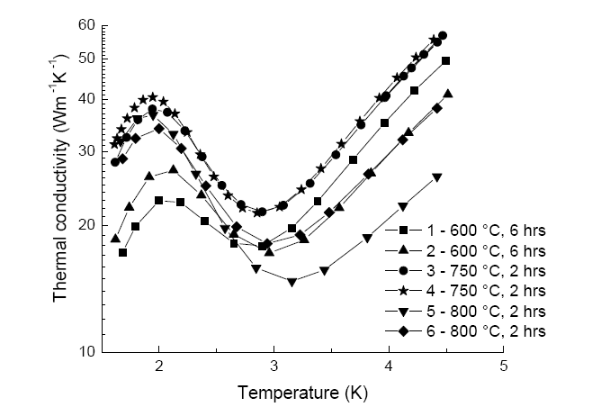
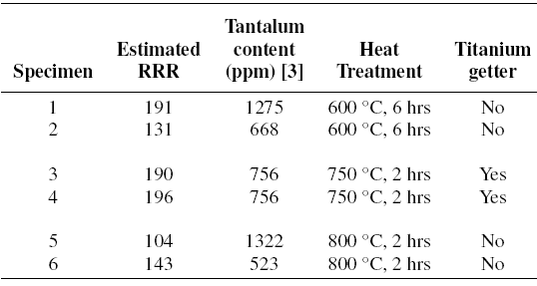
Tantalum and RRR have minimal influence on phonon peak
Ingot niobium
Saravan
PhD student at MSU

Slide 21
Hydrogen absorption with BCP and EP
Very high equilibrium hydrogen activities (fugacity) have been estimated when Nb metal is in contact with water or BCP solution
Hydrogen is readily absorbed into Nb when the protective oxide layer is removed
Lower H fugacity's are obtained due to an anodic polarization of Nb during EP and hence lower hydrogen absorption
R.E. Ricker, G. R. Myneni, J. Res. Natl. Inst. Stand. Technol. 115, 353-371 (2010)
NIST/JLab

Slide 22
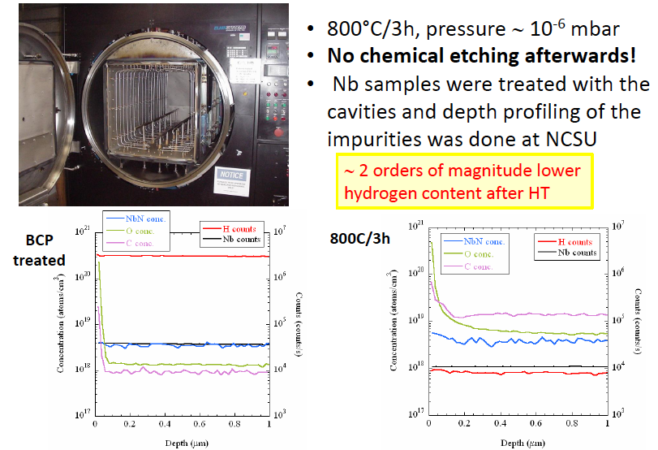
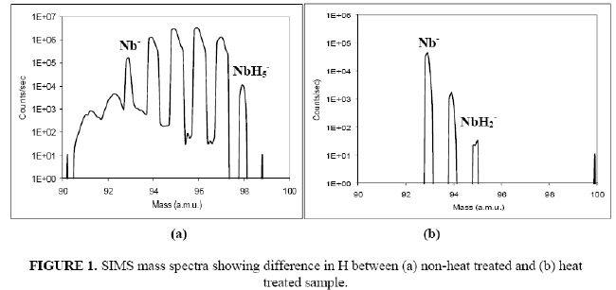
Heat treatment to remove hydrogen
Currently used furnaces contaminate the cavity surfaces, chemical re-etching reintroduces H
G. Ciovati, G. Myneni, F. Stevie, P. Maheshwari, and D. Griffis, Phys. Rev. ST Accel. Beams 13, 022002 (2010).

Slide 23
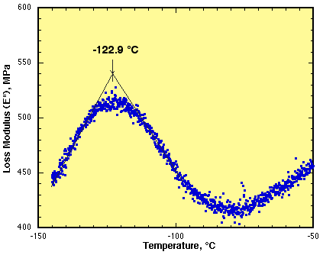
Hydrogen Interactions
N15 nuclear reaction analysis - UNY, Albany
Internal friction data - NIST, Gaithersburg
O-H Interaction Peak
Hydrogen is most mobile at room temperature, interacts with defects, interstitials and is
influenced by residual stress concentration gradients and affects the magnetic properties

Slide 24
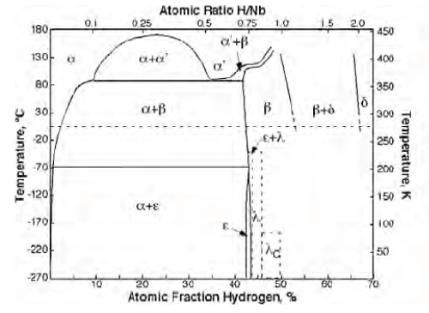
Niobium – hydrogen phase diagram
Solid solution
Beta forms below 150 °C and of the form
NbH less lossey
Beta transforms into Epsilon below -69 °C
Hydride phase and highly lossey

